Slide 1
PN-86HC1/PN-75HC1, PN70HC1E
Product Marketing Briefing
November 2019

Slide 2

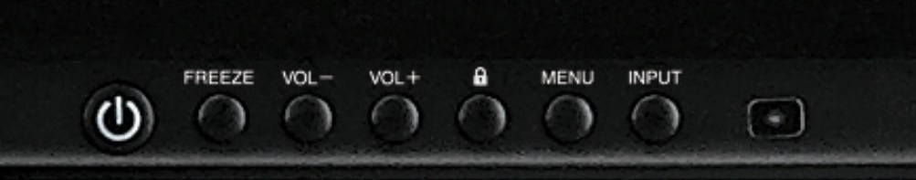

PN-86HC1/PN-75HC1, PN70HC1E
Key Features
4K Ultra HD entry level BIG PAD
Fast and responsive Infrared (IR) 20 point touch
(10 point touch for 70HC1E)
Built-in Whiteboard for PC less operation
Screen casting for Windows and Android devices
Quick access buttons and connections on front bezel
Media Player allowing playback images and video from inserted USB
Full size OPS slot
Sharp Pen Software

Slide 3

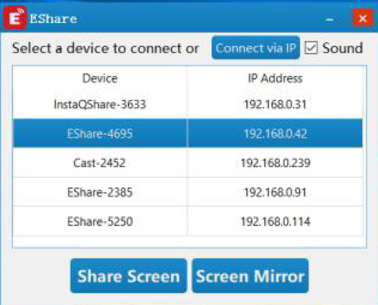
Wireless Screen Sharing with EShare
Screen casting for Windows and Android devices.
Mirror the ‘shared’ display on another display to act as a repeater. (EShare app running on connected PC)
Note – For Windows screen casting the display must be connected to the same network as PC via the LAN connected.
Android casting utilises the displays wireless adapter
Image of EShare app running on a Windows PC

Slide 4
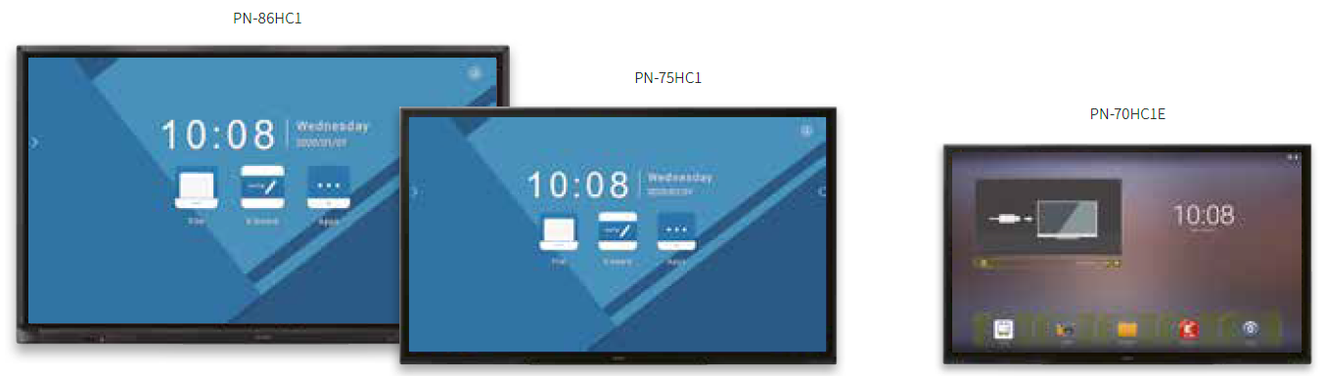
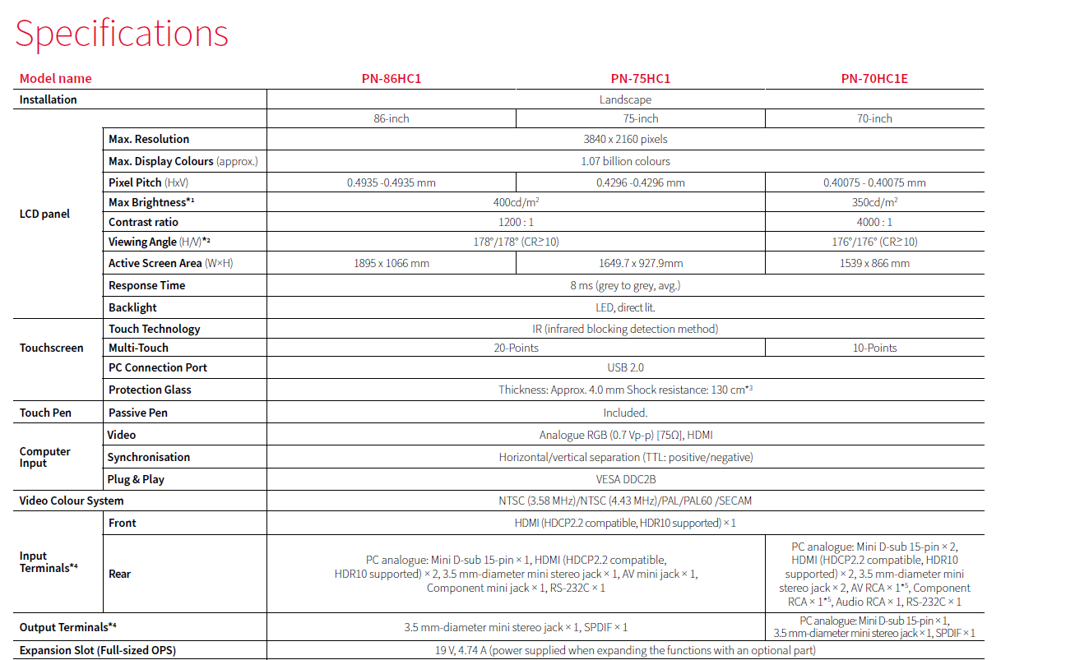
Model differences
The Launcher and built-in Whiteboard on the PN-70HC1E are different from that of the PN-86HC1 and PN-75HC1 models. Please refer to the brochure for full specification and model differences across the HC1 range.

Slide 5
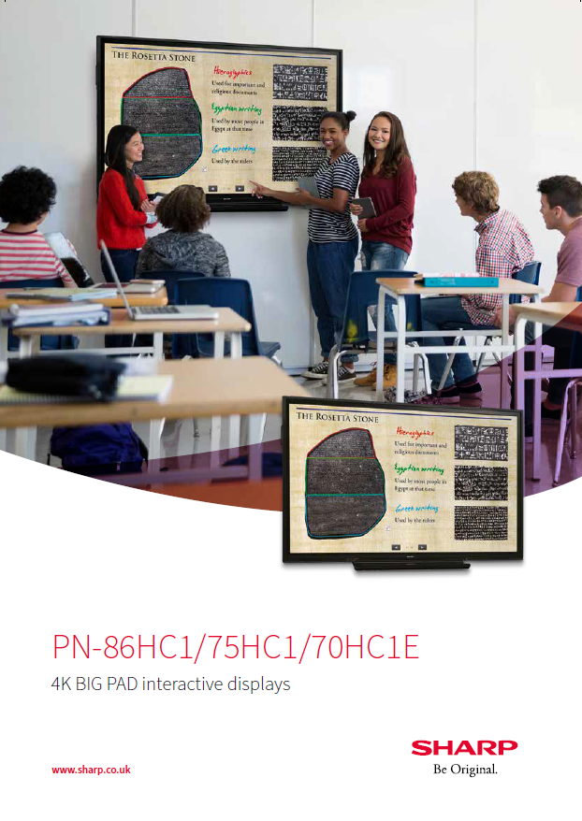
Collateral
Brochure
Data sheet
Website
SharpONE

Slide 6
Thank You
Matt Saunders
M 07709 334208
E matt.saunders@sharp.eu
W www.sharp.co.uk.

